Slide 1
C Programming Final Presentation
Given By Group 9
Talents come from diligence,aytfcel
and knowledge is gained by accumulation.
Notes:
亮亮图文旗舰店 亮亮图文旗舰店
https://liangliangtuwen.tmall.com

Slide 2
1
Problem statement
2
Analysis
CONTENT
3
Design
4
Implementation
5
Test

Slide 3
PART ONE
Problem statement

Slide 4

Background of our programme
Navigation system for freshmen
Huge campus
Complex roads
Various building

Slide 5
PART TWO
Analysis

Slide 6
Main Functions
Navigation system
Play bgm
Inquire information
Modify buildings
Find shortest road
Most crucial part

Slide 7
Problems to solve
How to make the map?
Algorithm to find shortest road?
How to save&change informatoin?
What if input is wrong?
Designing UI?
. . .
Use 2-dimensional array and different numbers to mark the roads and buildings
Based on breadth-first search
Write & read
files
Check whenever input and give a function to show all the buildings
Take advantage of the EasyX base
(graphics library)

Slide 8
PART THREE
Design

Slide 9
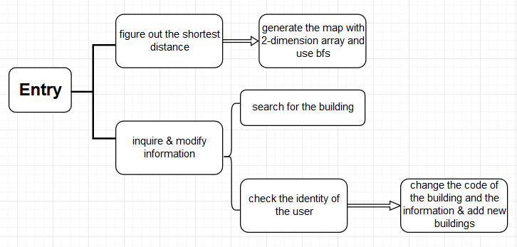
Flow charts
Main structure

Slide 10
Click button ”inquire information”
Flow charts
Input the name of building you are inquiring
Inquiring
information
Search for the name you input and judge whether it exists
F
Print “wrong input, please retry”
T
Print the information stores in the document

Slide 11
Click “modify buildings”
Flow charts
Modify
buildings
Input the administrator’s password
Judge the password is right or not
Print “wrong password”
Input the name of building you wang to change
T
F
Print several information of the building you just choose
Input the sequence number of the information you want to change
Input new information

Slide 12
PART FOUR
Implementation

Slide 13
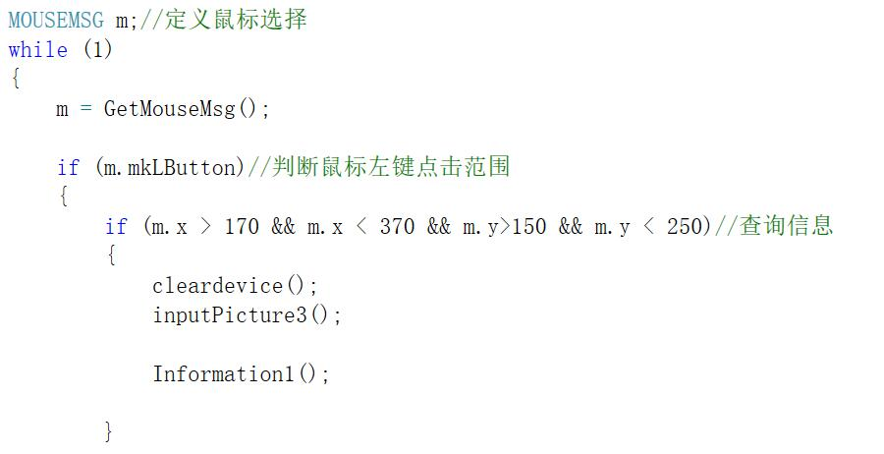
Our code
User interface

Slide 14
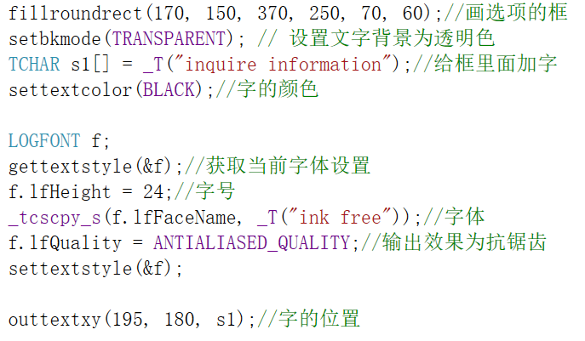
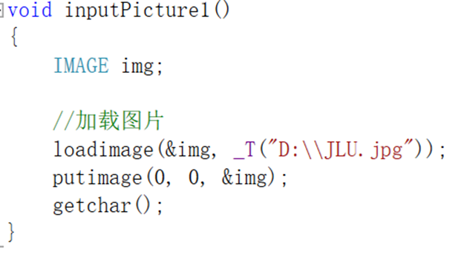
Our code
User interface

Slide 15
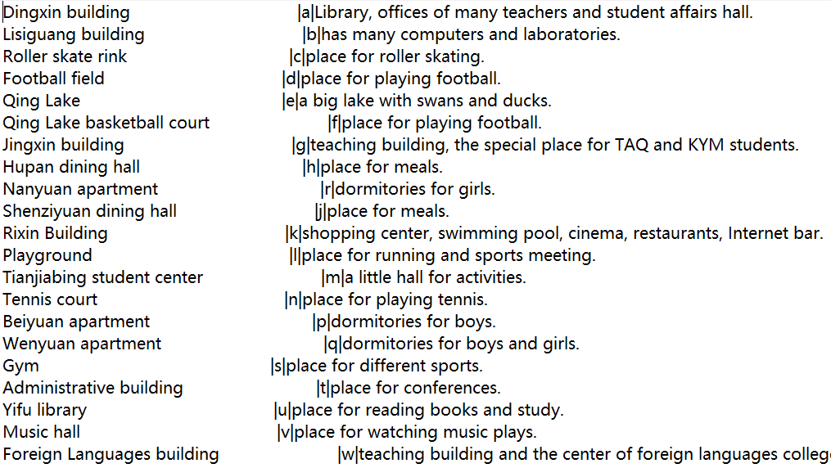
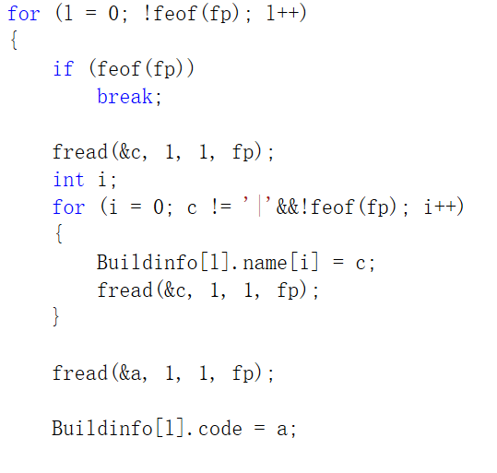
Our code
Storage of the information of buildings

Slide 16

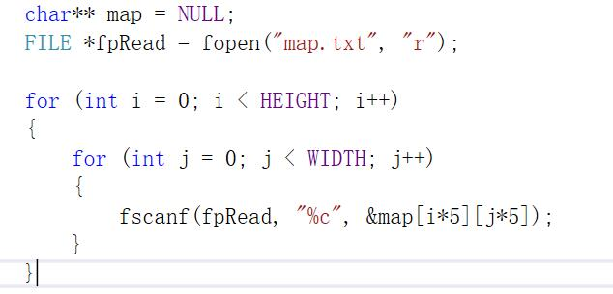
Our code
Generating map

Slide 17
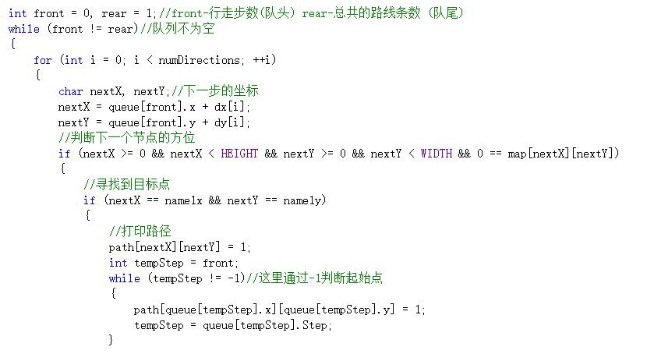
Our code
Breadth-first search

Slide 18
PART FIVE
Test

Slide 19
THANKS
By Group 9
Notes:
亮亮图文旗舰店 亮亮图文旗舰店
https://liangliangtuwen.tmall.com

